Slide 1
Chapter 4
Clustering
Course Outcomes
ITC602.4: Implement the appropriate data mining methods like classification, clustering or Frequent Pattern mining on large data sets.

Slide 2
Chapter 4. Clustering
What is Cluster Analysis?
Types of Data in Cluster Analysis
A Categorization of Major Clustering Methods
Partitioning Methods - K-Means, K-Mediods
Hierarchical Methods - Agglomerative, Divisive, BIRCH
Density-Based Methods - DBSCAN
Grid-Based Methods
Model-Based Methods
Clustering High-Dimensional Data
Constraint-Based Clustering
Outlier Analysis
Summary
04/14/21
Data Mining: Concepts and Techniques

Slide 3
What is Cluster Analysis?
Cluster: a collection of data objects
  Similar to one another within the same cluster
  Dissimilar to the objects in other clusters
Cluster analysis
  Finding similarities according to the characteristics found and grouping similar data objects into clusters
Unsupervised learning: no predefined classes
Typical applications
  As a stand-alone tool to get insight into data distribution
  As a preprocessing step for other algorithms
04/14/21

Slide 4
Clustering: Rich Applications and Multidisciplinary Efforts
Pattern Recognition
Spatial Data Analysis
  Create thematic maps in GIS by clustering feature spaces
  Detect spatial clusters or for other spatial mining tasks
Image Processing
Economic Science (especially market research)
WWW
  Document classification
  Cluster Weblog data to discover groups of similar access patterns
04/14/21
Data Mining: Concepts and Techniques

Slide 5
Examples of Clustering Applications
Marketing: Help marketers discover distinct groups in their customer bases, and then use this knowledge to develop targeted marketing programs
Land use: Identification of areas of similar land use in an earth observation database
Insurance: Identifying groups of motor insurance policy holders with a high average claim cost
City-planning: Identifying groups of houses according to their house type, value, and geographical location
Earth-quake studies: Observed earth quake epicenters should be clustered along continent faults
04/14/21
Data Mining: Concepts and Techniques

Slide 6
Quality: What Is Good Clustering?
A good clustering method will produce high quality clusters with
  high intra-class similarity
  low inter-class similarity
The quality of a clustering result depends on both the similarity measure used by the method and its implementation
The quality of a clustering method is also measured by its ability to discover some or all of the hidden patterns
04/14/21
Data Mining: Concepts and Techniques

Slide 7
Measure the Quality of Clustering
Dissimilarity/Similarity metric: Similarity is expressed in terms of a distance function, typically metric: d(i, j)
There is a separate “quality” function that measures the “goodness” of a cluster.
The definitions of distance functions are usually very different for interval-scaled, boolean, categorical, ordinal ratio, and vector variables.
Weights should be associated with different variables based on applications and data semantics.
It is hard to define “similar enough” or “good enough”
  the answer is typically highly subjective.
04/14/21
Data Mining: Concepts and Techniques

Slide 8
Requirements of Clustering in Data Mining
Scalability
Ability to deal with different types of attributes
Ability to handle dynamic data
Discovery of clusters with arbitrary shape
Minimal requirements for domain knowledge to determine input parameters
Able to deal with noise and outliers
Insensitive to order of input records
High dimensionality
Incorporation of user-specified constraints
Interpretability and usability
04/14/21
Data Mining: Concepts and Techniques

Slide 9
Chapter 4. Clustering
What is Cluster Analysis?
Types of Data in Cluster Analysis
A Categorization of Major Clustering Methods
Partitioning Methods
Hierarchical Methods
Density-Based Methods
Grid-Based Methods
Model-Based Methods
Clustering High-Dimensional Data
Constraint-Based Clustering
Outlier Analysis
Summary
04/14/21
Data Mining: Concepts and Techniques

Slide 10
Chapter 4. Clustering
What is Cluster Analysis?
Types of Data in Cluster Analysis
A Categorization of Major Clustering Methods
Partitioning Methods - K-Means, K-Mediods
Hierarchical Methods - Agglomerative, Divisive, BIRCH
Density-Based Methods - DBSCAN
Grid-Based Methods
Model-Based Methods
Clustering High-Dimensional Data
Constraint-Based Clustering
Outlier Analysis
Summary
04/14/21
Data Mining: Concepts and Techniques

Slide 11
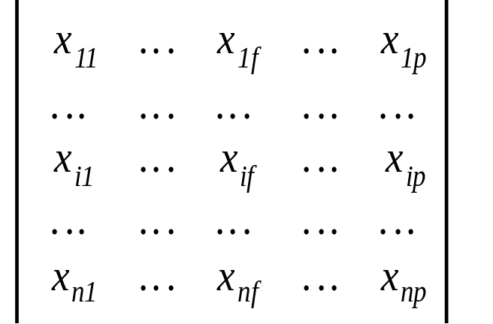
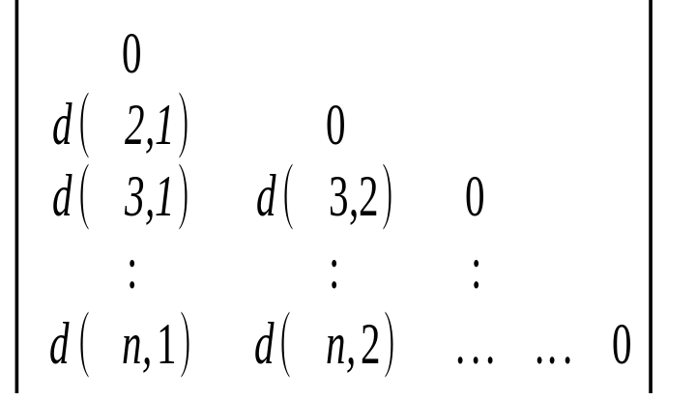
Data Structures
Data matrix
  (two modes)
Dissimilarity matrix
  (one mode)
04/14/21
Data Mining: Concepts and Techniques

Slide 12
Type of data in clustering analysis
Interval-scaled variables
Binary variables
Nominal, ordinal, and ratio variables
Variables of mixed types
04/14/21
Data Mining: Concepts and Techniques

Slide 13

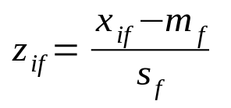
Interval-valued variables
Standardize data
  Calculate the mean absolute deviation:
  where
  Calculate the standardized measurement (z-score)
Using mean absolute deviation is more robust than using standard deviation
04/14/21
Data Mining: Concepts and Techniques

Slide 14
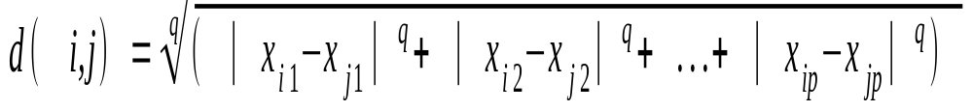
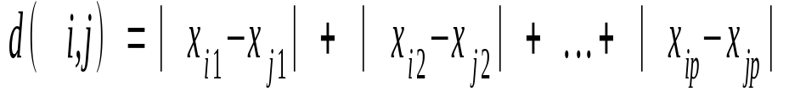
Similarity and Dissimilarity Between Objects
Distances are normally used to measure the similarity or dissimilarity between two data objects
Some popular ones include: Minkowski distance:
  where i = (x_{i1}, x_{i2}, …, x_{ip}) and j = (x_{j1}, x_{j2}, …, x_{jp}) are two p-dimensional data objects, and q is a positive integer
If q = 1, d is Manhattan distance
04/14/21
Data Mining: Concepts and Techniques

Slide 15
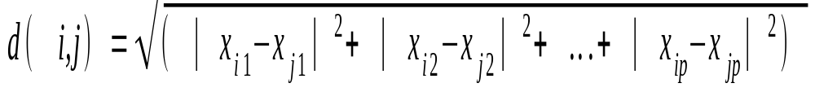
Similarity and Dissimilarity Between Objects (Cont.)
If q = 2, d is Euclidean distance:
  Properties
    d(i,j) ≥ 0
    d(i,i) = 0
    d(i,j) = d(j,i)
    d(i,j) ≤ d(i,k) + d(k,j)
Also, one can use weighted distance, parametric Pearson product moment correlation, or other disimilarity measures
04/14/21
Data Mining: Concepts and Techniques

Slide 16
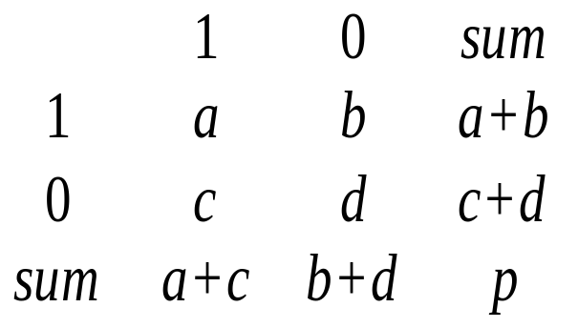
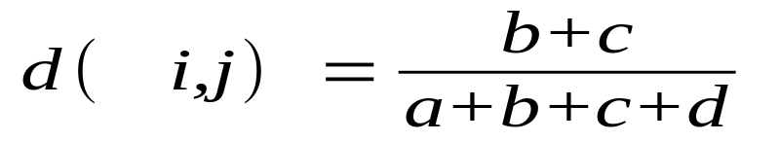
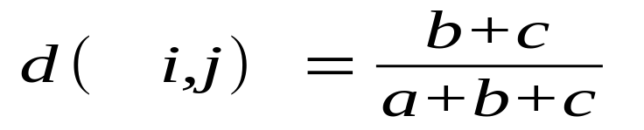
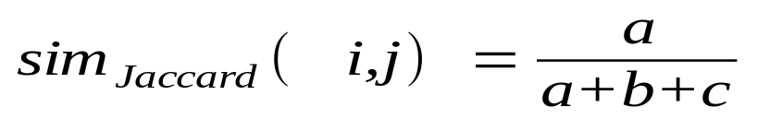
Binary Variables
Object j
A contingency table for binary data
Distance measure for symmetric binary variables:
Distance measure for asymmetric binary variables:
Jaccard coefficient (similarity measure for asymmetric binary variables):
Object i
04/14/21

Slide 17
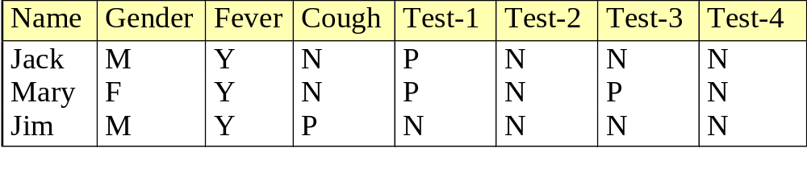
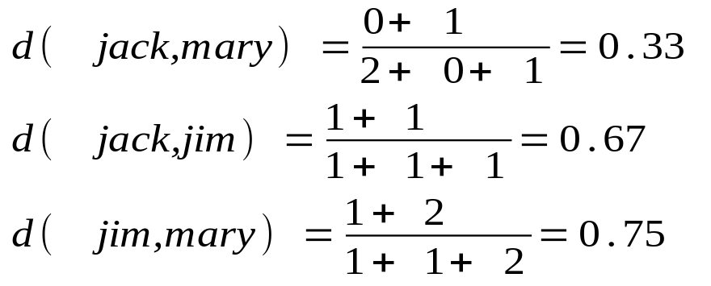
Dissimilarity between Binary Variables
Example
  gender is a symmetric attribute
  the remaining attributes are asymmetric binary
  let the values Y and P be set to 1, and the value N be set to 0
04/14/21

Slide 18
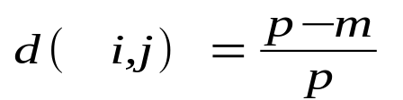
Nominal Variables
A generalization of the binary variable in that it can take more than 2 states, e.g., red, yellow, blue, green
Method 1: Simple matching
  m: # of matches, p: total # of variables
Method 2: use a large number of binary variables
  creating a new binary variable for each of the M nominal states
04/14/21
Data Mining: Concepts and Techniques

Slide 19

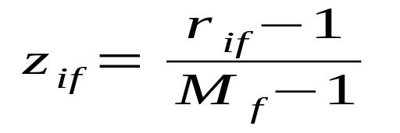
Ordinal Variables
An ordinal variable can be discrete or continuous
Order is important, e.g., rank
Can be treated like interval-scaled
replace x_{if} by their rank, r_{if} Ɛ {1,...,M_{f}}
  map the range of each variable onto [0, 1] by replacing i-th object in the f-th variable by
  compute the dissimilarity using methods for interval-scaled variables
04/14/21
Data Mining: Concepts and Techniques

Slide 20
Ratio-Scaled Variables
Ratio-scaled variable: a positive measurement on a nonlinear scale, approximately at exponential scale, such as Ae^{Bt} or Ae^{-Bt}
Methods:
  treat them like interval-scaled variables—not a good choice! (why?—the scale can be distorted)
  apply logarithmic transformation and treat it as interval-valued,
y_{if} = log(x_{if})
  treat them as continuous ordinal data treat their rank as interval-scaled
04/14/21

Slide 21
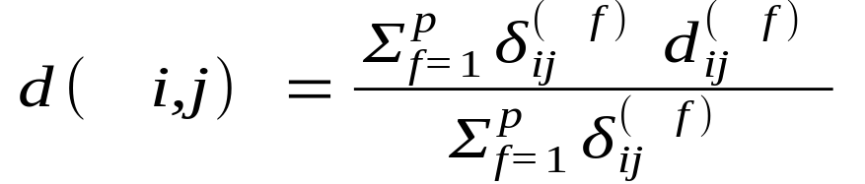
Variables of Mixed Types
A database may contain all the six types of variables
  symmetric binary, asymmetric binary, nominal, ordinal, interval and ratio
One may use a weighted formula to combine their effects
  f is binary or nominal:
    d_{ij}^{(f)} = 0 if x_{if} = x_{jf} , or d_{ij}^{(f)} = 1 otherwise
  f is interval-based: use the normalized distance
  f is ordinal or ratio-scaled
    compute ranks r_{if} and
    and treat z_{if} as interval-scaled
04/14/21

Slide 22

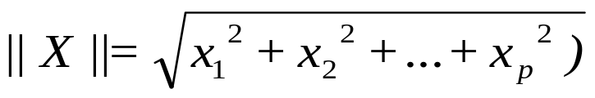

Vector Objects
Vector objects: keywords in documents, gene features in micro-arrays, etc.
Broad applications: information retrieval, biologic taxonomy, etc.
Cosine measure
Euclidean norm of vector X (x₁, x₂, …..x_{p})
A variant: Tanimoto coefficient
04/14/21
Data Mining: Concepts and Techniques

Slide 23
Chapter 7. Cluster Analysis
What is Cluster Analysis?
Types of Data in Cluster Analysis
A Categorization of Major Clustering Methods
Partitioning Methods
Hierarchical Methods
Density-Based Methods
Grid-Based Methods
Model-Based Methods
Clustering High-Dimensional Data
Constraint-Based Clustering
Outlier Analysis
Summary
04/14/21
Data Mining: Concepts and Techniques

Slide 24
Chapter 4. Clustering
What is Cluster Analysis?
Types of Data in Cluster Analysis
A Categorization of Major Clustering Methods
Partitioning Methods - K-Means, K-Mediods
Hierarchical Methods - Agglomerative, Divisive, BIRCH
Density-Based Methods - DBSCAN
Grid-Based Methods
Model-Based Methods
Clustering High-Dimensional Data
Constraint-Based Clustering
Outlier Analysis
Summary
04/14/21
Data Mining: Concepts and Techniques

Slide 25
Major Clustering Approaches (I)
Partitioning approach:
  Construct various partitions and then evaluate them by some criterion, e.g., minimizing the sum of square errors
  Typical methods: k-means, k-medoids, CLARANS
Hierarchical approach:
  Create a hierarchical decomposition of the set of data (or objects) using some criterion
  Typical methods: Diana, Agnes, BIRCH, ROCK, CAMELEON
Density-based approach:
  Based on connectivity and density functions
  Typical methods: DBSACN, OPTICS, DenClue
04/14/21
Data Mining: Concepts and Techniques

Slide 26
Major Clustering Approaches (II)
Grid-based approach:
  based on a multiple-level granularity structure
  Typical methods: STING, WaveCluster, CLIQUE
Model-based:
  A model is hypothesized for each of the clusters and tries to find the best fit of that model to each other
  Typical methods: EM, SOM, COBWEB
Frequent pattern-based:
  Based on the analysis of frequent patterns
  Typical methods: pCluster
User-guided or constraint-based:
  Clustering by considering user-specified or application-specific constraints
  Typical methods: COD (obstacles), constrained clustering
04/14/21

Slide 27
Typical Alternatives to Calculate the Distance between Clusters
Single link: smallest distance between an element in one cluster and an element in the other, i.e., dis(K_{i}, K_{j}) = min(t_{ip}, t_{jq})
Complete link: largest distance between an element in one cluster and an element in the other, i.e., dis(K_{i}, K_{j}) = max(t_{ip}, t_{jq})
Average: avg distance between an element in one cluster and an element in the other, i.e., dis(K_{i}, K_{j}) = avg(t_{ip}, t_{jq})
Centroid: distance between the centroids of two clusters, i.e., dis(K_{i}, K_{j}) = dis(C_{i}, C_{j})
Medoid: distance between the medoids of two clusters, i.e., dis(K_{i}, K_{j}) = dis(M_{i}, M_{j})
  Medoid: one chosen, centrally located object in the cluster
04/14/21

Slide 28
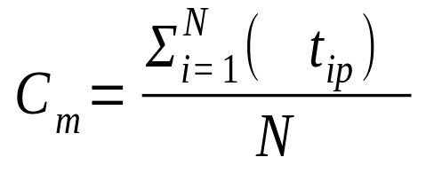
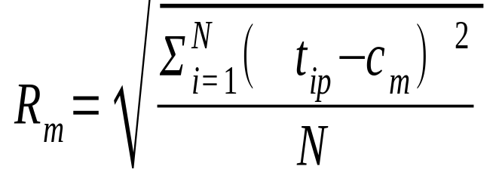
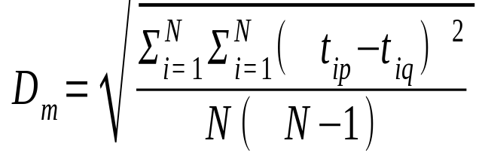
Centroid, Radius and Diameter of a Cluster (for numerical data sets)
Centroid: the “middle” of a cluster
Radius: square root of average distance from any point of the cluster to its centroid
Diameter: square root of average mean squared distance between all pairs of points in the cluster
04/14/21
Data Mining: Concepts and Techniques

Slide 29
Chapter 7. Cluster Analysis
What is Cluster Analysis?
Types of Data in Cluster Analysis
A Categorization of Major Clustering Methods
Partitioning Methods
Hierarchical Methods
Density-Based Methods
Grid-Based Methods
Model-Based Methods
Clustering High-Dimensional Data
Constraint-Based Clustering
Outlier Analysis
Summary
04/14/21
Data Mining: Concepts and Techniques

Slide 30
Chapter 4. Clustering
What is Cluster Analysis?
Types of Data in Cluster Analysis
A Categorization of Major Clustering Methods
Partitioning Methods - K-Means, K-Mediods
Hierarchical Methods - Agglomerative, Divisive, BIRCH
Density-Based Methods - DBSCAN
Grid-Based Methods
Model-Based Methods
Clustering High-Dimensional Data
Constraint-Based Clustering
Outlier Analysis
Summary
04/14/21
Data Mining: Concepts and Techniques

Slide 31
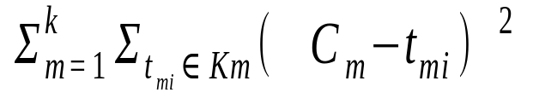
Partitioning Algorithms: Basic Concept
Partitioning method: Construct a partition of a database D of n objects into a set of k clusters, s.t., min sum of squared distance
Given a k, find a partition of k clusters that optimizes the chosen partitioning criterion
  Global optimal: exhaustively enumerate all partitions
  Heuristic methods: k-means and k-medoids algorithms
  k-means (MacQueen’67): Each cluster is represented by the center of the cluster
  k-medoids or PAM (Partition around medoids) (Kaufman & Rousseeuw’87): Each cluster is represented by one of the objects in the cluster
04/14/21
Data Mining: Concepts and Techniques

Slide 32
The K-Means Clustering Method
Given k, the k-means algorithm is implemented in four steps:
  Partition objects into k nonempty subsets
  Compute seed points as the centroids of the clusters of the current partition (the centroid is the center, i.e., mean point, of the cluster)
  Assign each object to the cluster with the nearest seed point
  Go back to Step 2, stop when no more new assignment
04/14/21
Data Mining: Concepts and Techniques

Slide 33
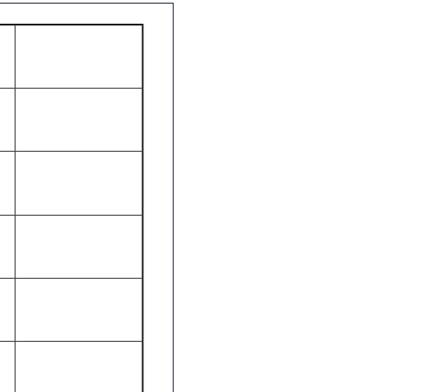
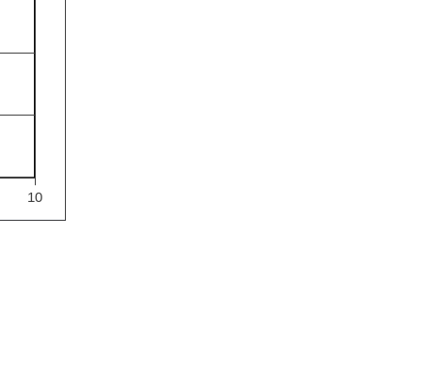
The K-Means Clustering Method
Example
10
10
9
9
8
8
7
7
6
6
5
5
4
Assign each objects to most similar center
Update the cluster means
4
3
3
2
2
1
1
0
0
0
1
2
3
4
5
6
7
8
9
10
0
1
2
3
4
5
6
7
8
9
10
reassign
reassign
K=2
Arbitrarily choose K object as initial cluster center
Update the cluster means
04/14/21
Data Mining: Concepts and Techniques

Slide 34
Comments on the K-Means Method
Strength: Relatively efficient: O(tkn), where n is # objects, k is # clusters, and t is # iterations. Normally, k, t << n.
    Comparing: PAM: O(k(n-k)² ), CLARA: O(ks² + k(n-k))
Comment: Often terminates at a local optimum. The global optimum may be found using techniques such as: deterministic annealing and genetic algorithms
Weakness
  Applicable only when mean is defined, then what about categorical data?
  Need to specify k, the number of clusters, in advance
  Unable to handle noisy data and outliers
  Not suitable to discover clusters with non-convex shapes
04/14/21
Data Mining: Concepts and Techniques

Slide 35
Variations of the K-Means Method
A few variants of the k-means which differ in
  Selection of the initial k means
  Dissimilarity calculations
  Strategies to calculate cluster means
Handling categorical data: k-modes (Huang’98)
  Replacing means of clusters with modes
  Using new dissimilarity measures to deal with categorical objects
  Using a frequency-based method to update modes of clusters
  A mixture of categorical and numerical data: k-prototype method
04/14/21
Data Mining: Concepts and Techniques

Slide 36
What Is the Problem of the K-Means Method?
The k-means algorithm is sensitive to outliers !
  Since an object with an extremely large value may substantially distort the distribution of the data.
K-Medoids: Instead of taking the mean value of the object in a cluster as a reference point, medoids can be used, which is the most centrally located object in a cluster.
10
10
9
9
8
8
7
7
6
6
5
5
4
4
3
3
2
2
1
1
0
0
1
2
3
4
5
6
7
8
9
10
0
0
1
2
3
4
5
6
7
8
9
10
04/14/21
Data Mining: Concepts and Techniques

Slide 37
The K-Medoids Clustering Method
Find representative objects, called medoids, in clusters
PAM (Partitioning Around Medoids, 1987)
  starts from an initial set of medoids and iteratively replaces one of the medoids by one of the non-medoids if it improves the total distance of the resulting clustering
  PAM works effectively for small data sets, but does not scale well for large data sets
CLARA (Kaufmann & Rousseeuw, 1990)
CLARANS (Ng & Han, 1994): Randomized sampling
Focusing + spatial data structure (Ester et al., 1995)
04/14/21
Data Mining: Concepts and Techniques

Slide 38

A Typical K-Medoids Algorithm (PAM)
Total Cost = 20
10
9
8
Arbitrary choose k object as initial medoids
Assign each remaining object to nearest medoids
7
6
5
4
3
2
1
0
0
1
2
3
4
5
6
7
8
9
10
K=2
Randomly select a nonmedoid object,O_{ramdom}
Total Cost = 26
Do loop
Until no change
10
10
9
Compute total cost of swapping
9
Swapping O and O_{ramdom}
If quality is improved.
8
8
7
7
6
6
5
5
4
4
3
3
2
2
1
1
04/14/21
0
0
1
2
3
4
5
6
7
8
9
10
0
0
1
2
3
4
5
6
7
8
9
10
Data Mining: Concepts and Techniques

Slide 39
PAM (Partitioning Around Medoids) (1987)
PAM (Kaufman and Rousseeuw, 1987), built in Splus
Use real object to represent the cluster
  Select k representative objects arbitrarily
  For each pair of non-selected object h and selected object i, calculate the total swapping cost TC_{ih}
  For each pair of i and h,
    If TC_{ih} < 0, i is replaced by h
    Then assign each non-selected object to the most similar representative object
  repeat steps 2-3 until there is no change
04/14/21
Data Mining: Concepts and Techniques

Slide 40

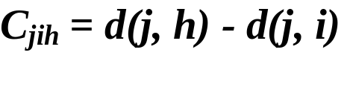





PAM Clustering: Total swapping cost TC_{ih}=∑_{j}C_{jih}
t
j
t
j
i
h
h
i
h
j
i
i
t
h
j
t
04/14/21
Data Mining: Concepts and Techniques

Slide 41
What Is the Problem with PAM?
Pam is more robust than k-means in the presence of noise and outliers because a medoid is less influenced by outliers or other extreme values than a mean
Pam works efficiently for small data sets but does not scale well for large data sets.
  O(k(n-k)² ) for each iteration
where n is # of data,k is # of clusters
Sampling based method,
CLARA(Clustering LARge Applications)
04/14/21
Data Mining: Concepts and Techniques

Slide 42
CLARA (Clustering Large Applications) (1990)
CLARA (Kaufmann and Rousseeuw in 1990)
  Built in statistical analysis packages, such as S+
It draws multiple samples of the data set, applies PAM on each sample, and gives the best clustering as the output
Strength: deals with larger data sets than PAM
Weakness:
  Efficiency depends on the sample size
  A good clustering based on samples will not necessarily represent a good clustering of the whole data set if the sample is biased
04/14/21

Slide 43
CLARANS (“Randomized” CLARA) (1994)
CLARANS (A Clustering Algorithm based on Randomized Search) (Ng and Han’94)
CLARANS draws sample of neighbors dynamically
The clustering process can be presented as searching a graph where every node is a potential solution, that is, a set of k medoids
If the local optimum is found, CLARANS starts with new randomly selected node in search for a new local optimum
It is more efficient and scalable than both PAM and CLARA
Focusing techniques and spatial access structures may further improve its performance (Ester et al.’95)
04/14/21

Slide 44
Chapter 4. Clustering
What is Cluster Analysis?
Types of Data in Cluster Analysis
A Categorization of Major Clustering Methods
Partitioning Methods - K-Means, K-Mediods
Hierarchical Methods - Agglomerative, Divisive, BIRCH
Density-Based Methods - DBSCAN
Grid-Based Methods
Model-Based Methods
Clustering High-Dimensional Data
Constraint-Based Clustering
Outlier Analysis
Summary
04/14/21
Data Mining: Concepts and Techniques

Slide 45
Hierarchical Clustering
Use distance matrix as clustering criteria. This method does not require the number of clusters k as an input, but needs a termination condition
Step 0
Step 1
Step 2
Step 3
Step 4
agglomerative
(AGNES)
a
a b
b
a b c d e
c
c d e
d
d e
e
divisive
(DIANA)
Step 4
Step 3
Step 2
Step 1
Step 0
04/14/21

Slide 46
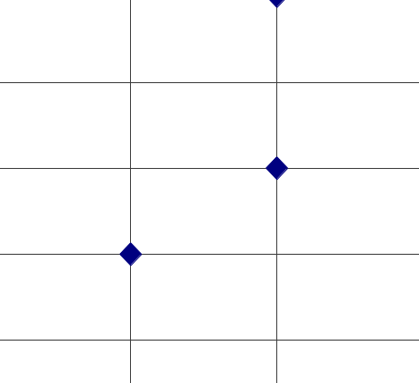
AGNES (Agglomerative Nesting)
Introduced in Kaufmann and Rousseeuw (1990)
Implemented in statistical analysis packages, e.g., Splus
Use the Single-Link method and the dissimilarity matrix.
Merge nodes that have the least dissimilarity
Go on in a non-descending fashion
Eventually all nodes belong to the same cluster
04/14/21
Data Mining: Concepts and Techniques

Slide 47
Dendrogram: Shows How the Clusters are Merged
  Decompose data objects into a several levels of nested partitioning (tree of clusters), called a dendrogram.
  A clustering of the data objects is obtained by cutting the dendrogram at the desired level, then each connected component forms a cluster.
04/14/21
Data Mining: Concepts and Techniques

Slide 48
Distance between Clusters
Single link: smallest distance between an element in one cluster and an element in the other, i.e., dis(K_{i}, K_{j}) = min(t_{ip}, t_{jq})
Complete link: largest distance between an element in one cluster and an element in the other, i.e., dis(K_{i}, K_{j}) = max(t_{ip}, t_{jq})
Average: avg distance between an element in one cluster and an element in the other, i.e., dis(K_{i}, K_{j}) = avg(t_{ip}, t_{jq})
Centroid: distance between the centroids of two clusters, i.e., dis(K_{i}, K_{j}) = dis(C_{i}, C_{j})
Medoid: distance between the medoids of two clusters, i.e., dis(K_{i}, K_{j}) = dis(M_{i}, M_{j})
  Medoid: one chosen, centrally located object in the cluster
04/14/21

Slide 49
DIANA (Divisive Analysis)
Introduced in Kaufmann and Rousseeuw (1990)
Implemented in statistical analysis packages, e.g., Splus
Inverse order of AGNES
Eventually each node forms a cluster on its own
04/14/21
Data Mining: Concepts and Techniques

Slide 50
Recent Hierarchical Clustering Methods
Major weakness of agglomerative clustering methods
  do not scale well: time complexity of at least O(n²), where n is the number of total objects
  can never undo what was done previously
Integration of hierarchical with distance-based clustering
  BIRCH (1996): uses CF-tree and incrementally adjusts the quality of sub-clusters
  ROCK (1999): clustering categorical data by neighbor and link analysis
  CHAMELEON (1999): hierarchical clustering using dynamic modeling
04/14/21
Data Mining: Concepts and Techniques

Slide 51
BIRCH (1996)
Birch: Balanced Iterative Reducing and Clustering using Hierarchies (Zhang, Ramakrishnan & Livny, SIGMOD’96)
Designed for clustering large amount of numerical data by integration of hierarchical clustering (at the initial microclustering stage) and other clustering methods (at later macroclustering stage).
Scales linearly: finds a good clustering with a single scan and improves the quality with a few additional scans
Weakness: handles only numeric data, and sensitive to the order of the data record.
It overcomes 2 difficulties of agglomerative clustering methods 1) scalability 2) the inability to undo what was done in the previous step
04/14/21
Data Mining: Concepts and Techniques

Slide 52
BIRCH
BIRCH introduces 2 concepts, to summarize cluster representations
Clustering feature (CF) and Clustering Feature tree (CF-tree)
These structures help to achieve good speed and scalability in large databases and also make it effective for incremental and dynamic clustering of incoming objects
Incrementally construct a CF (Clustering Feature) tree, a hierarchical data structure for multiphase clustering
  Phase 1: scan DB to build an initial in-memory CF tree (a multi-level compression of the data that tries to preserve the inherent clustering structure of the data)
  Phase 2: use an arbitrary clustering algorithm to cluster the leaf nodes of the CF-tree
04/14/21
Data Mining: Concepts and Techniques

Slide 53
Centroid, Radius and Diameter of a Cluster (for numerical data sets)
Centroid: the “middle” of a cluster
Radius: square root of average distance from any point of the cluster to its centroid
Diameter: square root of average mean squared distance between all pairs of points in the cluster
04/14/21
Data Mining: Concepts and Techniques

Slide 54
Clustering Feature Vector in BIRCH
04/14/21
Data Mining: Concepts and Techniques

Slide 55
Clustering Feature Vector in BIRCH
Clustering Feature: CF = (N, LS, SS)
N: Number of data points
LS: ∑^{N}_{i=1}=X_{i}
SS: ∑^{N}_{i=1}=X_{i}²
CF = (5, (16,30),(54,190))
(3,4)
(2,6)
(4,5)
(4,7)
(3,8)
04/14/21
Data Mining: Concepts and Techniques

Slide 56

CF-Tree in BIRCH
Clustering feature:
  summary of the statistics for a given subcluster: the 0-th, 1st and 2nd moments of the subcluster from the statistical point of view.
  registers crucial measurements for computing cluster and utilizes storage efficiently
A CF tree is a height-balanced tree that stores the clustering features for a hierarchical clustering
  A nonleaf node in a tree has descendants or “children”
  The nonleaf nodes store sums of the CFs of their children
A CF tree has two parameters
  Branching factor: specify the maximum number of children.
  threshold: max diameter of sub-clusters stored at the leaf nodes
04/14/21

Slide 57
The CF Tree Structure
Root
B = 7
L = 6
CF₁
CF₂
CF₃
CF₆
child₁
child₂
child₃
child₆
Non-leaf node
CF₁
CF₂
CF₃
CF₅
child₁
child₂
child₃
child₅
Leaf node
Leaf node
prev
CF₁
CF₂
CF₆
next
prev
CF₁
CF₂
CF₄
next
04/14/21
Data Mining: Concepts and Techniques

Slide 58
Chapter 4. Clustering
What is Cluster Analysis?
Types of Data in Cluster Analysis
A Categorization of Major Clustering Methods
Partitioning Methods - K-Means, K-Mediods
Hierarchical Methods - Agglomerative, Divisive, BIRCH
Density-Based Methods - DBSCAN
Grid-Based Methods
Model-Based Methods
Clustering High-Dimensional Data
Constraint-Based Clustering
Outlier Analysis
Summary
04/14/21
Data Mining: Concepts and Techniques

Slide 59
Density-Based Clustering Methods
Clustering based on density (local cluster criterion), such as density-connected points
Major features:
  Discover clusters of arbitrary shape
  Handle noise
  One scan
  Need density parameters as termination condition
Several interesting studies:
  DBSCAN: Ester, et al. (KDD’96)
  OPTICS: Ankerst, et al (SIGMOD’99).
  DENCLUE: Hinneburg & D. Keim (KDD’98)
  CLIQUE: Agrawal, et al. (SIGMOD’98) (more grid-based)
04/14/21
Data Mining: Concepts and Techniques

Slide 60
Density-Based Clustering: Basic Concepts
Two parameters:
  Eps: Maximum radius of the neighbourhood
  MinPts: Minimum number of points in an Eps-neighbourhood of that point
N_{Eps}(p): {q belongs to D | dist(p,q) <= Eps}
Directly density-reachable: A point p is directly density-reachable from a point q w.r.t. Eps, MinPts if
  p belongs to N_{Eps}(q)
  core point condition:
  |N_{Eps} (q)| >= MinPts
p
MinPts = 5
Eps = 1 cm
q
04/14/21
Data Mining: Concepts and Techniques

Slide 61
Density-Reachable and Density-Connected
Density-reachable:
  A point p is density-reachable from a point q w.r.t. Eps, MinPts if there is a chain of points p₁, …, p_{n}, p₁ = q, p_{n} = p such that p_{i+1} is directly density-reachable from p_{i}
Density-connected
  A point p is density-connected to a point q w.r.t. Eps, MinPts if there is a point o such that both, p and q are density-reachable from o w.r.t. Eps and MinPts
p
p₁
q
p
q
o
04/14/21
Data Mining: Concepts and Techniques

Slide 62
DBSCAN: Density Based Spatial Clustering of Applications with Noise
Relies on a density-based notion of cluster: A cluster is defined as a maximal set of density-connected points
Discovers clusters of arbitrary shape in spatial databases with noise
Outlier
Border
Eps = 1cm
MinPts = 5
Core
04/14/21
Data Mining: Concepts and Techniques

Slide 63
DBSCAN: The Algorithm
Arbitrary select a point p
Retrieve all points density-reachable from p w.r.t. Eps and MinPts.
If p is a core point, a cluster is formed.
If p is a border point, no points are density-reachable from p and DBSCAN visits the next point of the database.
Continue the process until all of the points have been processed.
04/14/21
Data Mining: Concepts and Techniques

Slide 64



DBSCAN: Sensitive to Parameters
04/14/21
Data Mining: Concepts and Techniques

Slide 65

CHAMELEON (Clustering Complex Objects)
04/14/21
Data Mining: Concepts and Techniques

Slide 66
OPTICS: A Cluster-Ordering Method (1999)
OPTICS: Ordering Points To Identify the Clustering Structure
  Ankerst, Breunig, Kriegel, and Sander (SIGMOD’99)
  Produces a special order of the database wrt its density-based clustering structure
  This cluster-ordering contains info equiv to the density-based clusterings corresponding to a broad range of parameter settings
  Good for both automatic and interactive cluster analysis, including finding intrinsic clustering structure
  Can be represented graphically or using visualization techniques
04/14/21
Data Mining: Concepts and Techniques

Slide 67
OPTICS: Some Extension from DBSCAN
Index-based:
    k = number of dimensions
    N = 20
    p = 75%
    M = N(1-p) = 5
  Complexity: O(kN²)
Core Distance
Reachability Distance
D
p1
o
p2
o
Max (core-distance (o), d (o, p))
r(p1, o) = 2.8cm. r(p2,o) = 4cm
MinPts = 5
ε = 3 cm
04/14/21
Data Mining: Concepts and Techniques

Slide 68
Chapter 4. Clustering
What is Cluster Analysis?
Types of Data in Cluster Analysis
A Categorization of Major Clustering Methods
Partitioning Methods - K-Means, K-Mediods
Hierarchical Methods - Agglomerative, Divisive, BIRCH
Density-Based Methods - DBSCAN
Grid-Based Methods
Model-Based Methods
Clustering High-Dimensional Data
Constraint-Based Clustering
Outlier Analysis
Summary
04/14/21
Data Mining: Concepts and Techniques

Slide 69
Outlier Analysis
What are outliers?
  The set of objects are considerably dissimilar from the remainder of the data
  Outlier can be caused by an error or may be result of inherent data variability.
Outlier may be of particular interest Ex: In fraud detection, outlier may indicate fraudulent activity.
Outlier detection and analysis – Outlier Mining
Applications:
  Credit card fraud detection
  Telecom fraud detection
  Medical analysis
04/14/21
Data Mining: Concepts and Techniques

Slide 70
Outlier Mining
Can be defined as
  Given a set of n data points and k, expected number of outliers, find top k objects that are dissimilar, exceptional or inconsistent w.r.t remaining data
Outlier mining problem viewed as 2 sub-problems
  define what data can be considered as inconsistent in given dataset
  find an efficient method to mine the outliers so defined
Categorization of approaches for outlier detection:
Statistical approach, distance –based approach, density-based local outlier approach & deviation-based approach
04/14/21
Data Mining: Concepts and Techniques

Slide 71

Outlier Discovery: Statistical Approaches
Assume a model underlying distribution that generates data set (e.g. normal distribution)
Use discordancy tests depending on
  data distribution
  distribution parameter (e.g., mean, variance)
  number of expected outliers
Drawbacks
  most tests are for single attribute
  In many cases, data distribution may not be known
04/14/21
Data Mining: Concepts and Techniques

Slide 72
Outlier Discovery: Distance-Based Approach
Introduced to counter the main limitations imposed by statistical methods
  We need multi-dimensional analysis without knowing data distribution
Distance-based outlier: A DB(p, D)-outlier is an object O in a dataset T such that at least a fraction p of the objects in T lies at a distance greater than D from O
Algorithms for mining distance-based outliers
  Index-based algorithm
  Nested-loop algorithm
  Cell-based algorithm
04/14/21
Data Mining: Concepts and Techniques

Slide 73
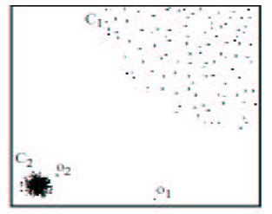
Density-Based Local Outlier Detection
Distance-based outlier detection is based on global distance distribution
It encounters difficulties to identify outliers if data is not uniformly distributed
Ex. C₁ contains 400 loosely distributed points, C₂ has 100 tightly condensed points, 2 outlier points o₁, o₂
Distance-based method cannot identify o₂ as an outlier
Need the concept of local outlier
Local outlier factor (LOF)
  Assume outlier is not crisp
  Each point has a LOF
04/14/21
Data Mining: Concepts and Techniques

Slide 74
Outlier Discovery: Deviation-Based Approach
Identifies outliers by examining the main characteristics of objects in a group
Objects that “deviate” from this description are considered outliers
Sequential exception technique
  simulates the way in which humans can distinguish unusual objects from among a series of supposedly like objects
OLAP data cube technique
  uses data cubes to identify regions of anomalies in large multidimensional data
04/14/21
Data Mining: Concepts and Techniques

Slide 75
Chapter 7. Cluster Analysis
What is Cluster Analysis?
Types of Data in Cluster Analysis
A Categorization of Major Clustering Methods
Partitioning Methods
Hierarchical Methods
Density-Based Methods
Grid-Based Methods
Model-Based Methods
Clustering High-Dimensional Data
Constraint-Based Clustering
Outlier Analysis
Summary
04/14/21
Data Mining: Concepts and Techniques

Slide 76
Summary
Cluster analysis groups objects based on their similarity and has wide applications
Measure of similarity can be computed for various types of data
Clustering algorithms can be categorized into partitioning methods, hierarchical methods, density-based methods, grid-based methods, and model-based methods
Computer-based Outlier analysis methods typically follow either a statistical-distribution based, a distance-based, a density-based or a deviation-based approach
There are still lots of research issues on cluster analysis
04/14/21
Data Mining: Concepts and Techniques

Slide 77
Problems and Challenges
Considerable progress has been made in scalable clustering methods
  Partitioning: k-means, k-medoids, CLARANS
  Hierarchical: BIRCH, ROCK, CHAMELEON
  Density-based: DBSCAN, OPTICS, DenClue
  Grid-based: STING, WaveCluster, CLIQUE
  Model-based: EM, Cobweb, SOM
  Frequent pattern-based: pCluster
  Constraint-based: COD, constrained-clustering
Current clustering techniques do not address all the requirements adequately, still an active area of research
04/14/21
Data Mining: Concepts and Techniques

Slide 78
References (1)
R. Agrawal, J. Gehrke, D. Gunopulos, and P. Raghavan. Automatic subspace clustering of high dimensional data for data mining applications. SIGMOD'98
M. R. Anderberg. Cluster Analysis for Applications. Academic Press, 1973.
M. Ankerst, M. Breunig, H.-P. Kriegel, and J. Sander. Optics: Ordering points to identify the clustering structure, SIGMOD’99.
P. Arabie, L. J. Hubert, and G. De Soete. Clustering and Classification. World Scientific, 1996
Beil F., Ester M., Xu X.: "Frequent Term-Based Text Clustering", KDD'02
M. M. Breunig, H.-P. Kriegel, R. Ng, J. Sander. LOF: Identifying Density-Based Local Outliers. SIGMOD 2000.
M. Ester, H.-P. Kriegel, J. Sander, and X. Xu. A density-based algorithm for discovering clusters in large spatial databases. KDD'96.
M. Ester, H.-P. Kriegel, and X. Xu. Knowledge discovery in large spatial databases: Focusing techniques for efficient class identification. SSD'95.
D. Fisher. Knowledge acquisition via incremental conceptual clustering. Machine Learning, 2:139-172, 1987.
D. Gibson, J. Kleinberg, and P. Raghavan. Clustering categorical data: An approach based on dynamic systems. VLDB’98.
04/14/21
Data Mining: Concepts and Techniques

Slide 79
References (2)
V. Ganti, J. Gehrke, R. Ramakrishan. CACTUS Clustering Categorical Data Using Summaries. KDD'99.
D. Gibson, J. Kleinberg, and P. Raghavan. Clustering categorical data: An approach based on dynamic systems. In Proc. VLDB’98.
S. Guha, R. Rastogi, and K. Shim. Cure: An efficient clustering algorithm for large databases. SIGMOD'98.
S. Guha, R. Rastogi, and K. Shim. ROCK: A robust clustering algorithm for categorical attributes. In ICDE'99, pp. 512-521, Sydney, Australia, March 1999.
A. Hinneburg, D.l A. Keim: An Efficient Approach to Clustering in Large Multimedia Databases with Noise. KDD’98.
A. K. Jain and R. C. Dubes. Algorithms for Clustering Data. Printice Hall, 1988.
G. Karypis, E.-H. Han, and V. Kumar. CHAMELEON: A Hierarchical Clustering Algorithm Using Dynamic Modeling. COMPUTER, 32(8): 68-75, 1999.
L. Kaufman and P. J. Rousseeuw. Finding Groups in Data: an Introduction to Cluster Analysis. John Wiley & Sons, 1990.
E. Knorr and R. Ng. Algorithms for mining distance-based outliers in large datasets. VLDB’98.
G. J. McLachlan and K.E. Bkasford. Mixture Models: Inference and Applications to Clustering. John Wiley and Sons, 1988.
P. Michaud. Clustering techniques. Future Generation Computer systems, 13, 1997.
R. Ng and J. Han. Efficient and effective clustering method for spatial data mining. VLDB'94.
04/14/21
Data Mining: Concepts and Techniques

Slide 80
References (3)
L. Parsons, E. Haque and H. Liu, Subspace Clustering for High Dimensional Data: A Review , SIGKDD Explorations, 6(1), June 2004
E. Schikuta. Grid clustering: An efficient hierarchical clustering method for very large data sets. Proc. 1996 Int. Conf. on Pattern Recognition,.
G. Sheikholeslami, S. Chatterjee, and A. Zhang. WaveCluster: A multi-resolution clustering approach for very large spatial databases. VLDB’98.
A. K. H. Tung, J. Han, L. V. S. Lakshmanan, and R. T. Ng. Constraint-Based Clustering in Large Databases, ICDT'01.
A. K. H. Tung, J. Hou, and J. Han. Spatial Clustering in the Presence of Obstacles , ICDE'01
H. Wang, W. Wang, J. Yang, and P.S. Yu. Clustering by pattern similarity in large data sets, SIGMOD’ 02.
W. Wang, Yang, R. Muntz, STING: A Statistical Information grid Approach to Spatial Data Mining, VLDB’97.
T. Zhang, R. Ramakrishnan, and M. Livny. BIRCH : an efficient data clustering method for very large databases. SIGMOD'96.
04/14/21
Data Mining: Concepts and Techniques

